Slide 1
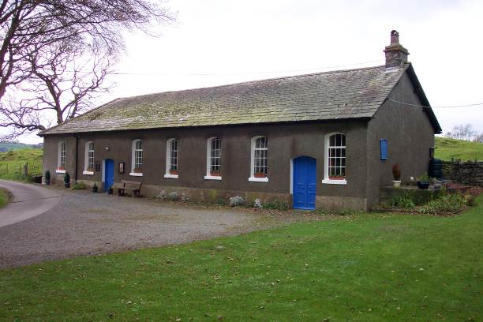
Tottlebank Church
A Church of Christ
-Early As 1669

Slide 2
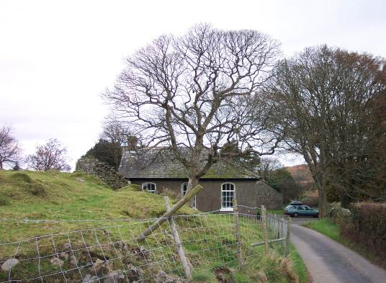
Attempting Restoration
In 1669, Charles II had been on the English throne for nine years.
Despite Charles’ inclination toward toleration, the early years of his reign were marked by a series of repressive measures, collectively known as the Clarendon Code.
Under the Code grave disabilities were placed on those who sought to worship outside the boundaries placed on them by the English church.
In particular the Conventicle Act banished any meetings of more than five people in addition to the household for worship other than in the prescribed form and location.

Slide 3
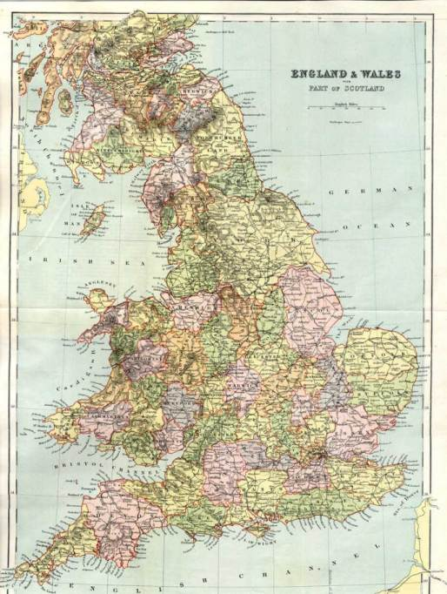
Escape To Remote Areas
Seven fled, two of whom had suffered severe penalties for violation, sought seclusion and solitude from London’s watchful eye!
They settled in England’s Northern Lake District, 200 miles to the NW of London

Slide 4
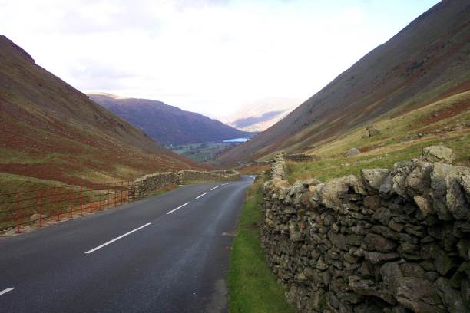
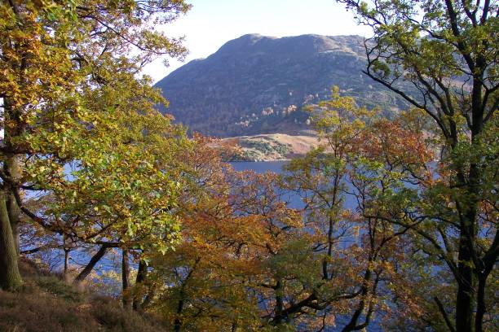
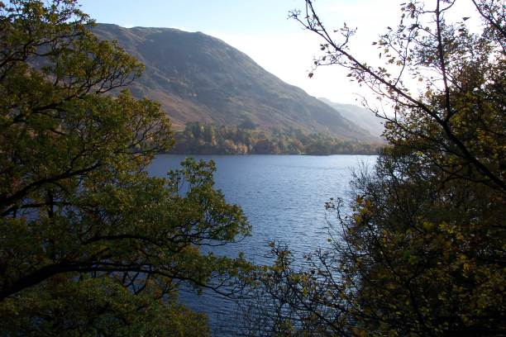
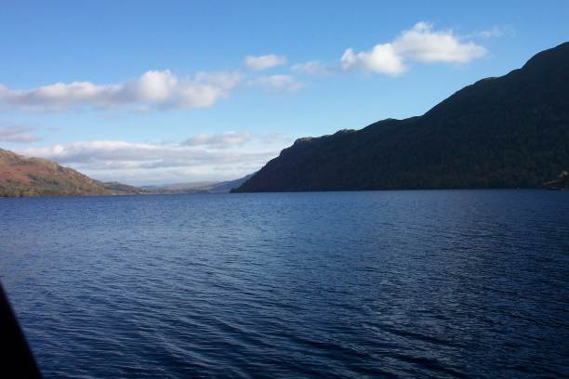
England’s Lake District
In 1669 the Convenicle Act ran out, and during the brief period before it was reinacted, The group drew up articles of organization as follows:

Slide 5
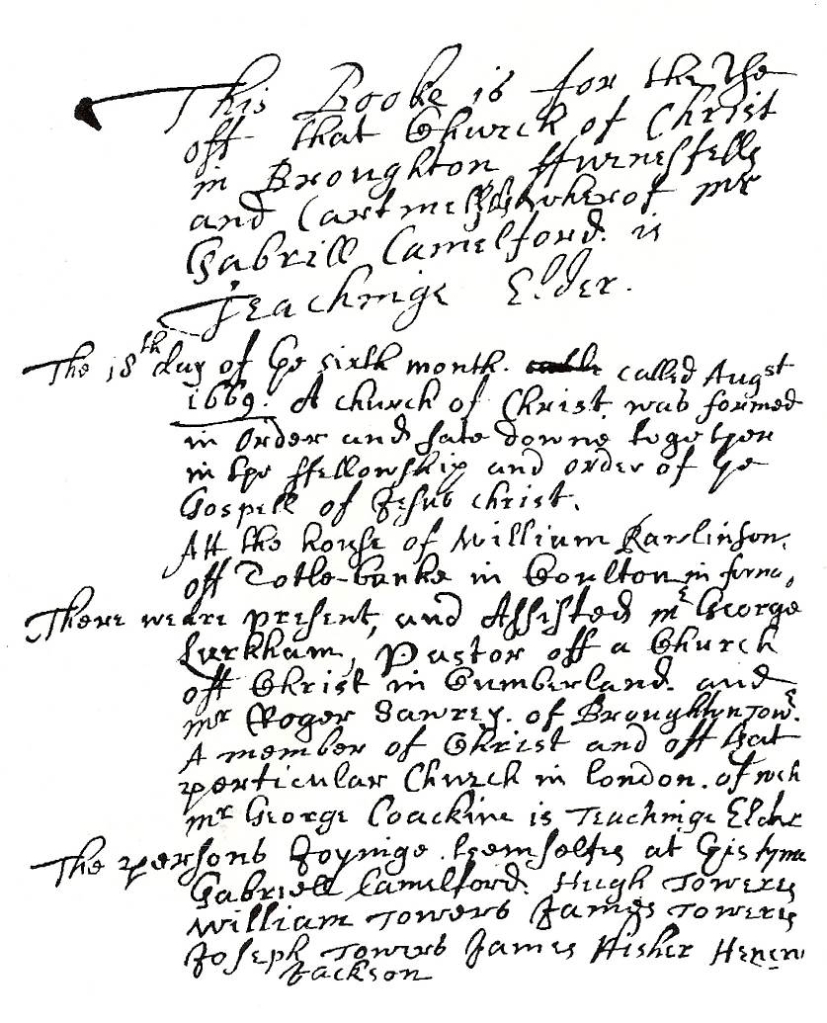
The Ledger
This booke is for the use of that Church of Christ in Broughton furnessfell and Cartmell whereof Mr. Gabrill Camelford is Teachinge Elder
The 18th day of ye sixth month called August 1669 A church of Christ was formed in order and sate down together in the fellowship and order of ye Gospel of Jesus Christ. Att the house of William Rawlinson off Totle-banke in Coulton in furness.

Slide 6
The Ledger
There were present and assisted Mr Geroge Larkham Pasto off a Church off Christ in Cumberland and Mr Roger Sawrey of Broughton Tower a member of Christ and off that particular Church in London of wych Mr George Coackine is Teaching Elder
The persons joyning themselves at this time Gabriel Camelford, Hugh Towers, William Towers, James Towers, Joseph Towers, James Fisher, Henery Jackson

Slide 7
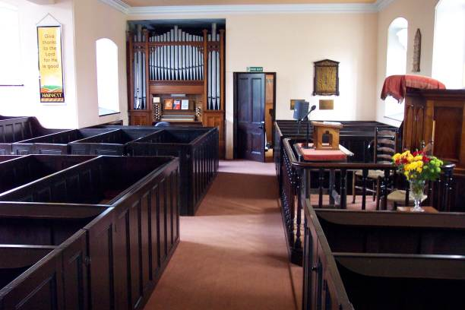
Organization
On 9th of November, 1669, articles of faith were drawn up.
“The Confession off ffaith held forth by the Church off Christ . . .”
Some Things The Lengthy document claims:
“The way of Separation from the world is the way off god.”
“with us is a door wide enough to entertaine every Sonn of ye lord of glory, we dare not barr the dore against any honest soule …desieringe much that we may all be helpful to each other…our table is large enough and provision suited for children, younge men and ffathers amonge the flock of Christ that shall consent with us and desier to sit down with us or amongst us.”

Slide 8
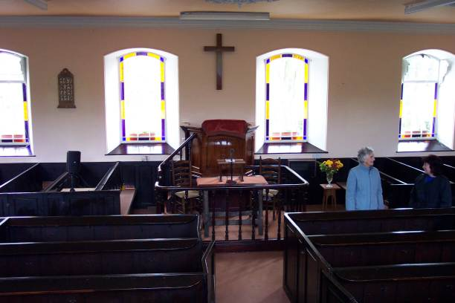
Organization
Seven Basic Principles Of Faith Were Listed According To Tottlebank Historian Foster Sutherland, 1969:
Repentance, Faith, Baptism of water and the spirit, laying on of hands, resurrection of the dead and eternal judgement.
Thankfulness to God and willingness to be the praise of His grace.
Dear love and affection to all saints.
The chiefest tie and bond is the bond of love, Christian, heavenly and unfeigned love.
The word of Christ is the utmost boundary of liberty.
“We desire and expect to receive help in our weakness and from another by the watchful aid of one another and the faithful reprehension and admonition one of another.”
Everything is to be referred to God and Christ, and when all is done they are to say, “Not unto us but unto Thy name be praise.”

Slide 9
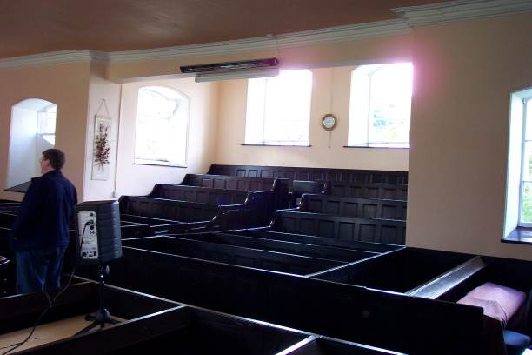
Organization
Infant baptism vs. adult baptism is not discussed in the book of faith.
They claimed church autonomy, having rights to its own affairs, claiming freedom to choose its own officers, to examine disagreements or “matters of scandall any way arrising amonge themselfes,”and to discipline if necessary by suspension, “on occation of obstinace and wilfull persistinge in any ennormous sinn,” with exclusion as the final resort.

Slide 10
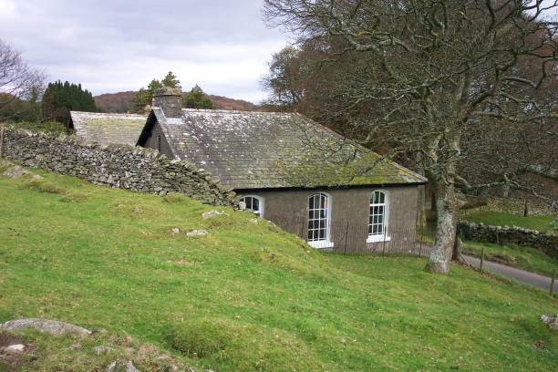
Outside Influences
1695 — London Minister, David Crossley introduced Baptist Theology, and the church became identified as a Baptist church, and is so to the present.

Slide 11
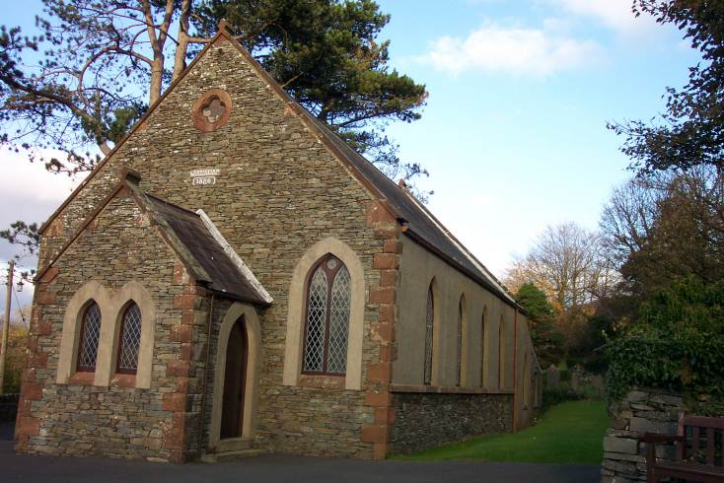
The Kirkby Church Planted
The Tottlebank church planted a church near the west coast that for years remained in fellowship with them.

Slide 12
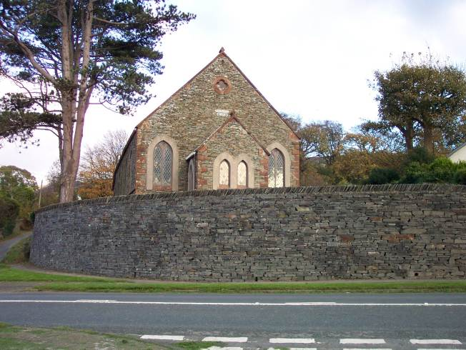
Kirkby Church of Christ
By 1824 a church after the ancient order was serving the Lord at Kirkby.
It was 30 years before any hear of Barton W. Stone or Alexander Campbell

Slide 13
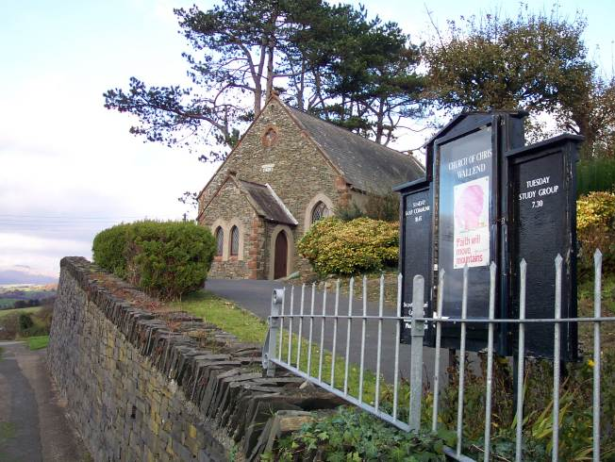
Kirkby Part In Digression
When the battle over the instrument raged, the Kirkby church added the instrument to its services
Today Kirkby church is known as Wall End Christian Church.
It is the oldest continuous restoration church in Great Britain

Slide 14
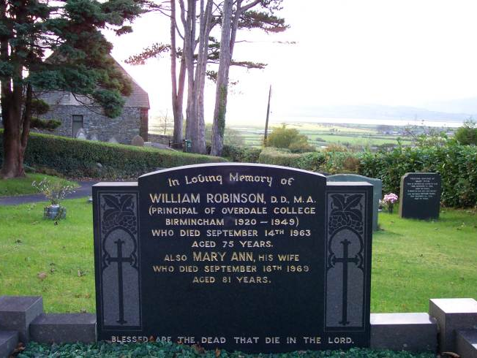
William Robinson
Long-time Restoration Preacher, buried in the cemetery at Wall End
Educator And Evangelist

Slide 15
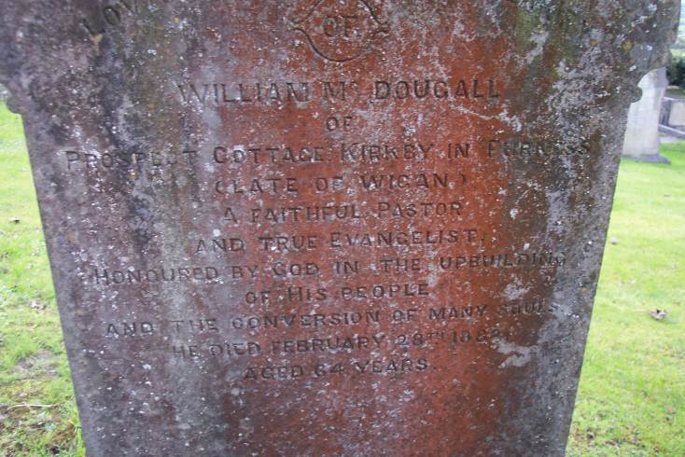
William M. McDougall Of Prospect Cottage Kirkby In Furness (Late Of Wigan) A Faithful Pastor And True Evangelist Honoured By God In The Upbuilding Of His People And The Conversion Of Many Souls He Died February 28, 1882 Aged 64 Years

